Slide 1
COGNITIVE AUTOMATION IN EVALUATING COMPANY ASSOCIATES FOR APPRAISAL PROCESS
VIT Vellore_Team Strark
1. NSB Vamsee Krishna (Leader)
Email : nsbvamsee.krishna2019@vitstudent.ac.in
2. Andrew Moses
Email : andrew2moses@gmail.com
3. Muvvala Venkata Aravinda Satvik
Email : aravindsatvik@gmail.com

Slide 2




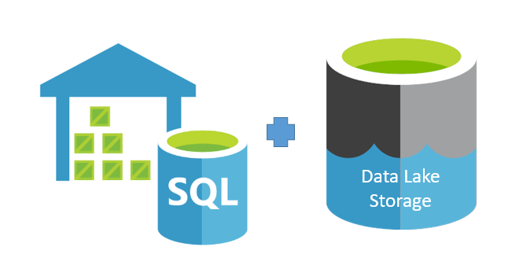




How we propose to solve!
1. Capture various contributions of an individual in an enterprise
Contribution on tracking tools
Documentation contribution
Code contribution
other unstructured involvement by parsing emails and raw text
time spent on calls / discussions
Attendance at meetups!
2. Both Structured and unstructured (raw text) are stored in a DB

Slide 3
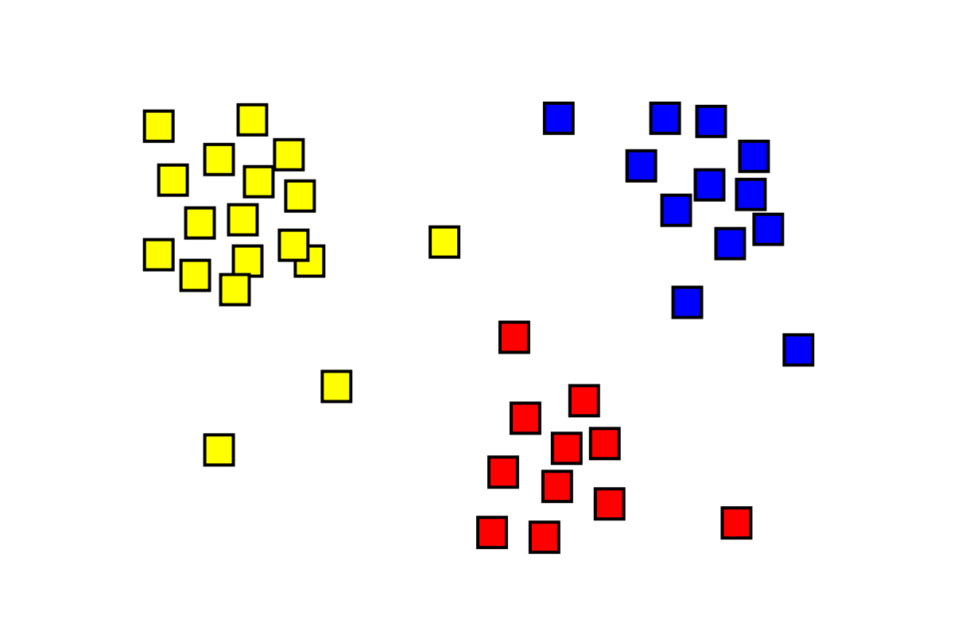

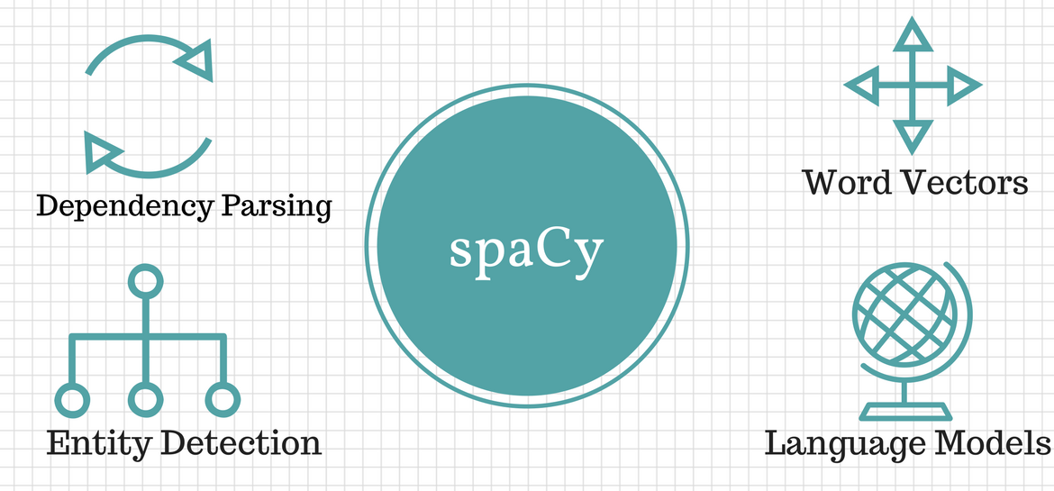
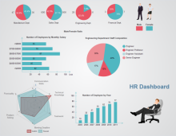
How we propose to solve!
3. Process unstructured data and come up with machine understand features
4. Clustering (unsupervised learning) to group associates.
5. Dashboard visualizing detailed content with varied parameters over time using the built model. Assisting decision makers

Slide 4
DETAILED BUSINESS CASE
The key idea of this business case is about building an intelligent system to track all the necessary parameters for evaluating the employee of a company and making a dashboard of it which can be very helpful in the appraisal process.
The parameters that we are tracking from an employee are code contribution in Git, issue tracking in Jira, document contribution in confluence, skype call logs to track whether the employee attended meetings or not and time spent on it, and tracking the emails sent or received by the employees.
This data extraction involves a certain set of tools and both structured and unstructured data(raw data) are stored in a database.
Then, the collected data has to be parsed which involves the process of analyzing the raw data into machine-understandable features.
Clustering has to be applied to unstructured data which is unsupervised learning to group the associates of a company.
Finally, a dashboard has to be created by visualizing all the obtained parameters.

Slide 5
SOLUTION DESIGN AND ARCHITECTURE
The proposed model evaluates the performance of different employees without any bias by rating their performance via different platforms such as git, jira, confluence, skype and emails.
This model takes different types of input parameters such as lines of code an employee contribute, number of issues solved by an employee, document contribution, email discussion between employees and number of meetings attended by an employee.
The input data used by this model is in the forms of both structured and unstructured (we cluster the unstructured data to form several clusters to group the associates of a company), parse them and store the data in a database. We use mongodb and mysql as our database servers.
Then an intelligent system is built using all the data to identify the top performers of the company in order to ease the appraisal process.
We use tableau and intelligent system to create a web based dashboard to visualize the data and measure the performance of the employees.

Slide 6
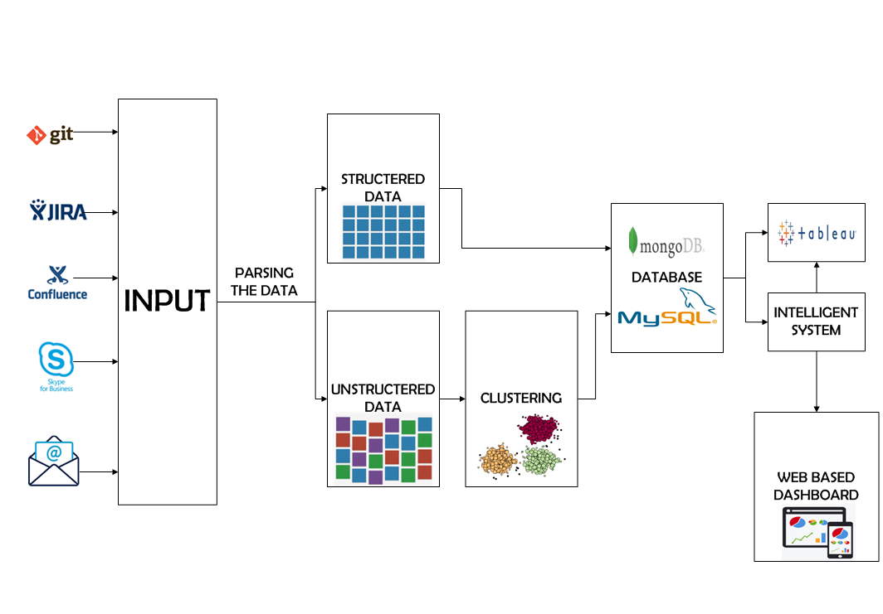
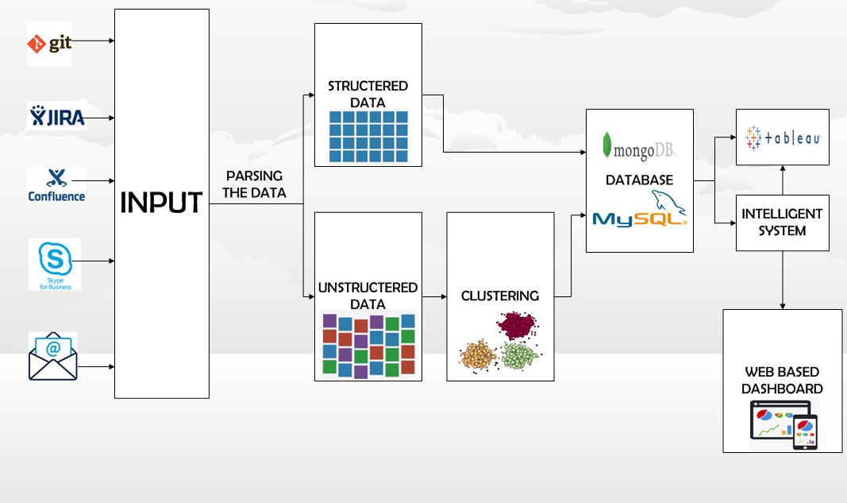
SOLUTION DESIGN AND ARCHITECTURE

Slide 7
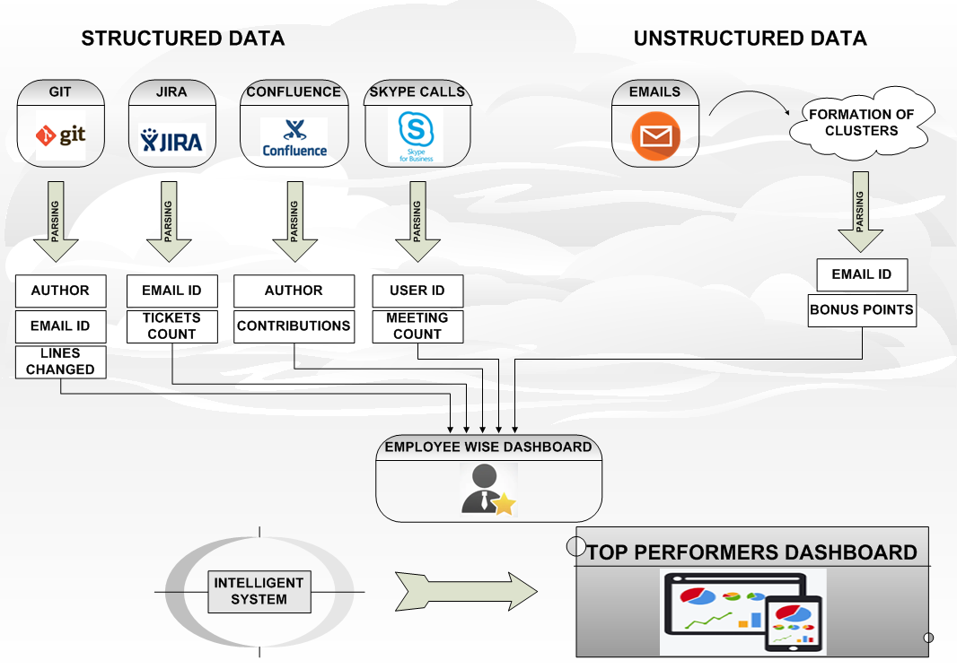
LOGICAL DATA MODEL

Slide 8
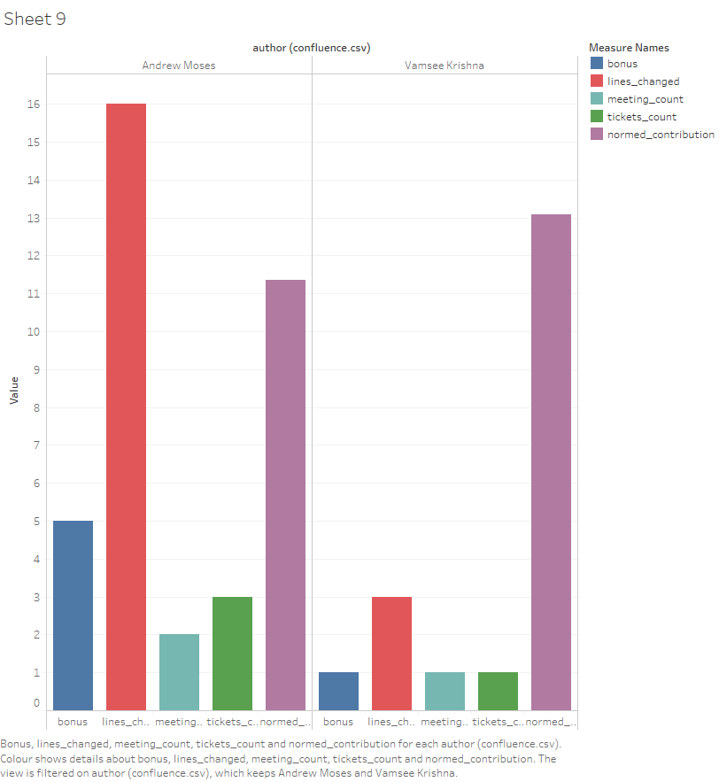
DATA VISUALIZATION IN TABLEAU

Slide 9
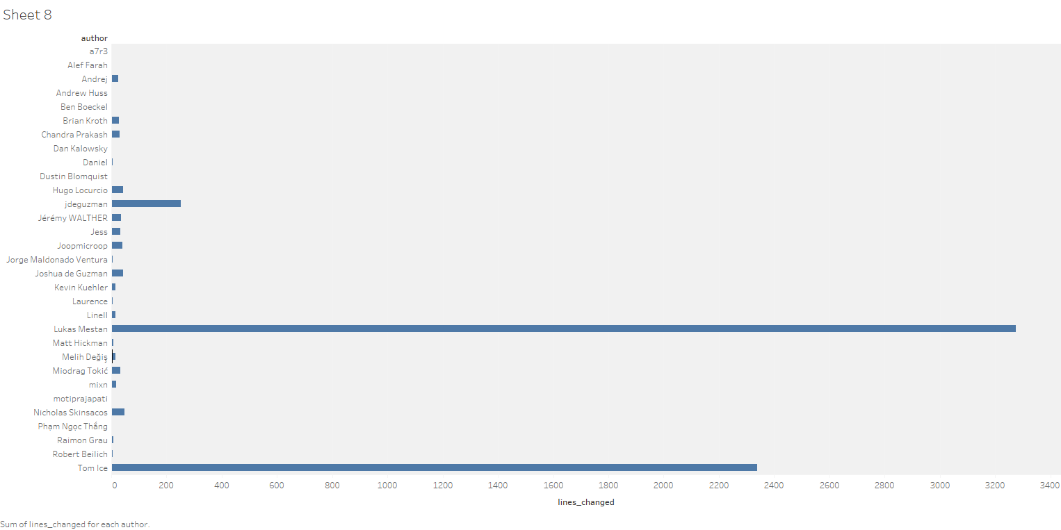

Slide 10
Things done till now:
Collected all the necessary raw data from the respective websites.
Parsed the structured raw data.
Divided the unstructured data into clusters and parsed them.
Created a tableau from the parsed data.
Things need to be done:
Storing all the data in a database.
Creating an intelligent system from the database.
Creating an employee wise dash-board and dash-board to identify the top performers.
THANK YOU

